Slide 1
Albert Gersten Pavilion Crime Study
Albert Gersten
Pavilion
By: Charles Robinson
Date created 4.23.22

Slide 2
Executive Summary
Crime peaked near Albert Gersten Pavilion in 2021.
A few key metrics:
95% of crimes were committed within 10 miles of this stadium
Crimes committed towards males and females with very close in numbers.
There was a peak in Auto thefts and hate crimes.

Slide 3
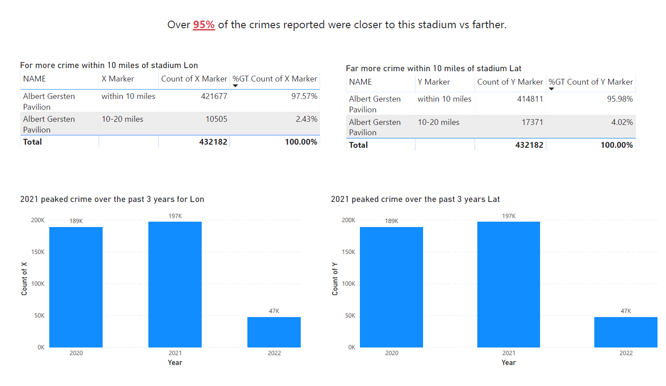

Slide 4
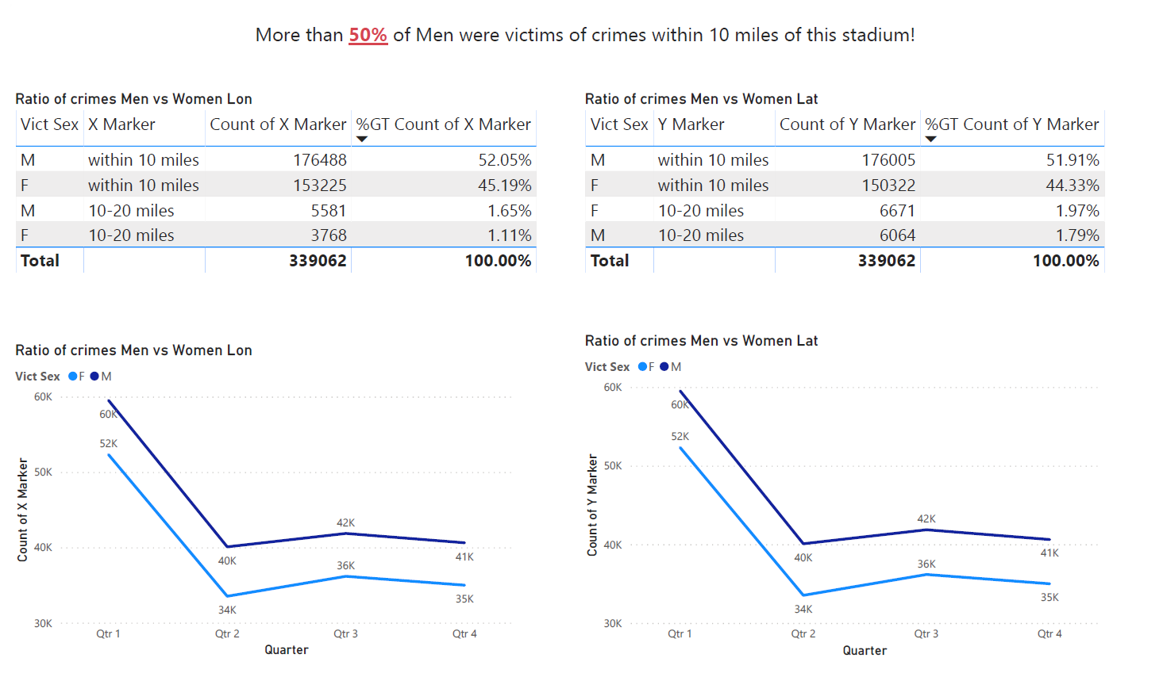

Slide 5
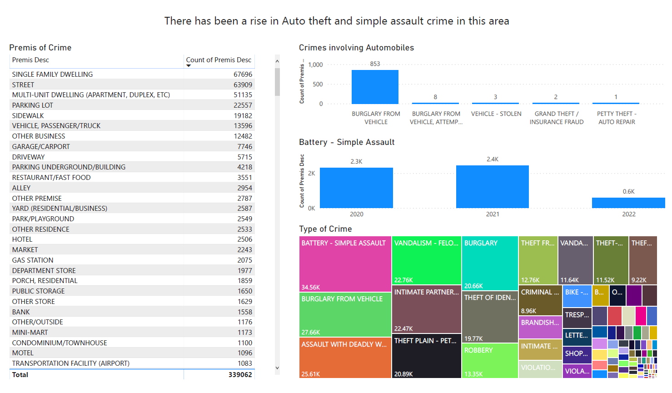

Slide 6
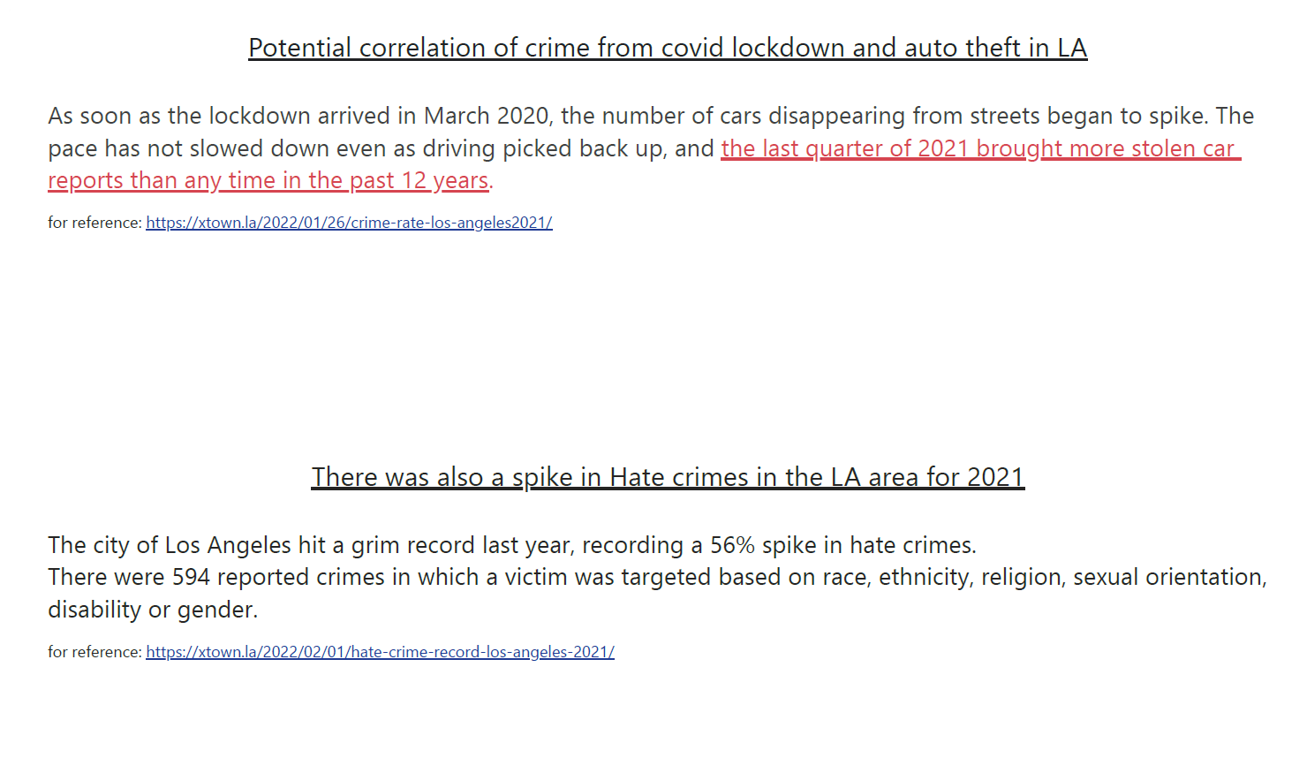

Slide 7
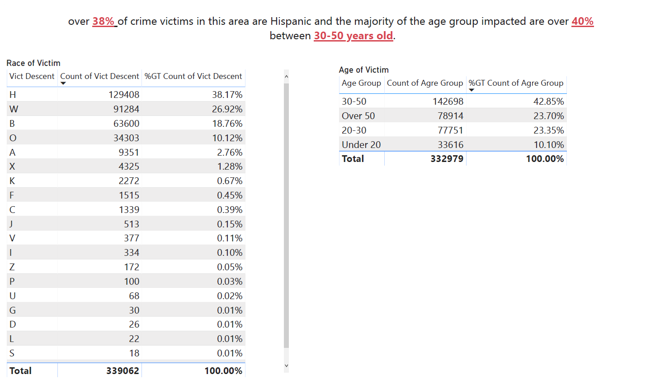

Slide 8
Suggestions from findings
Enhance police presence within 10 miles of this arena.
Q1 (jan – march)is more active with crime.
Keep an eye out for suspicious people near automobiles.
This might be a temporary spike in crime due to covid.
Hispanics and people between the ages of 30-40 are the majority of victims ensure this group is receiving extra attention.

Slide 9
Links and resources
Major Sports Venues
https://data.world/dhs/major-sport-venues/workspace/file?filename=Major_Sport_Venues.csv
Crime data - (missing data is shown as 0)
https://data.lacity.org/Public-Safety/Crime-Data-from-2020-to-Present/2nrs-mtv8/data

Slide 10
Code
Python Code:
https://colab.research.google.com/drive/15aLsSrCVySMV-J3VD2dY7SMAmzjfdm4V?usp=sharing
Power BI file:
https://drive.google.com/file/d/1nbs8wEm2XO3UmGcd4v5bh2XeIIyTTxht/view?usp=sharing

